Slide 1


땡
Enjoy your stylish business and campus life with BIZCAM
오픈소스소프트웨어실습 28조 (BE THE 1)
김승호, 신민규, 하예솜

Slide 2


BE THE 1
Enjoy your stylish business and campus life with BIZCAM
BE THE 1?
공모전 팀원 모집 사이트
“Be the 1 team, Be the 1 place”

Slide 3


BE THE 1
Enjoy your stylish business and campus life with BIZCAM
개발 언어?

Slide 4
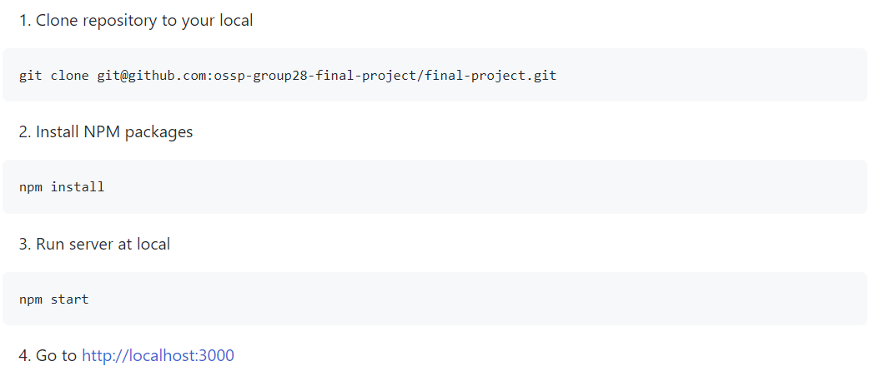
BE THE 1
Enjoy your stylish business and campus life with BIZCAM
How to run in local?

Slide 5

BE THE 1
Enjoy your stylish business and campus life with BIZCAM
How to use?
1. https://bethe1.herokuapp.com/ 접속

Slide 6
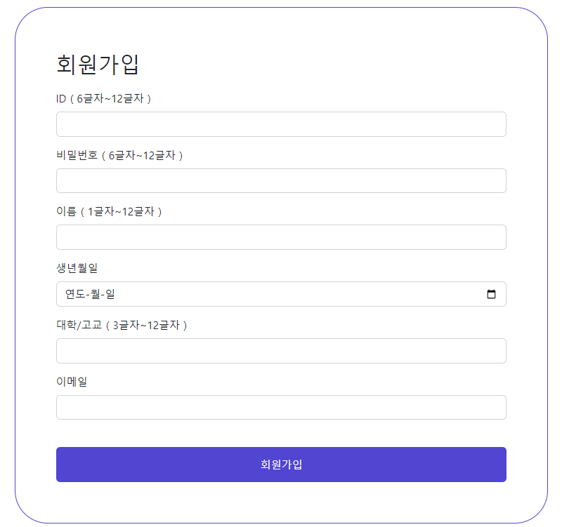
BE THE 1
Enjoy your stylish business and campus life with BIZCAM
How to use?
2. 회원가입하기
((주의)) 실제 사용하는 아이디 비번 넣지 않기

Slide 7
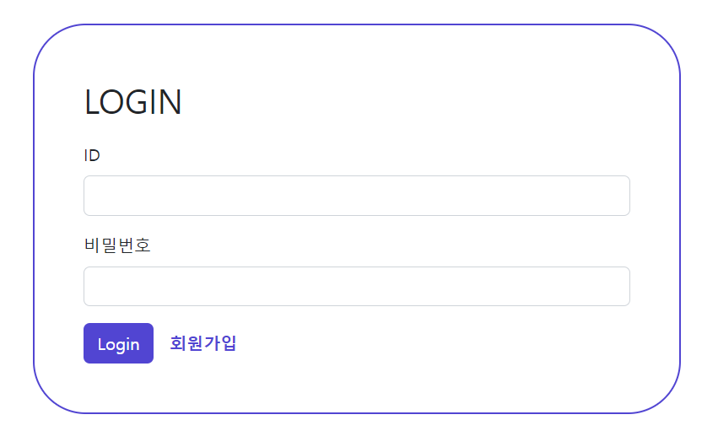
BE THE 1
Enjoy your stylish business and campus life with BIZCAM
How to use?
3. 회원 가입한 아이디와 비밀번호로 로그인하기

Slide 8

BE THE 1
Enjoy your stylish business and campus life with BIZCAM
Calendar

Slide 9
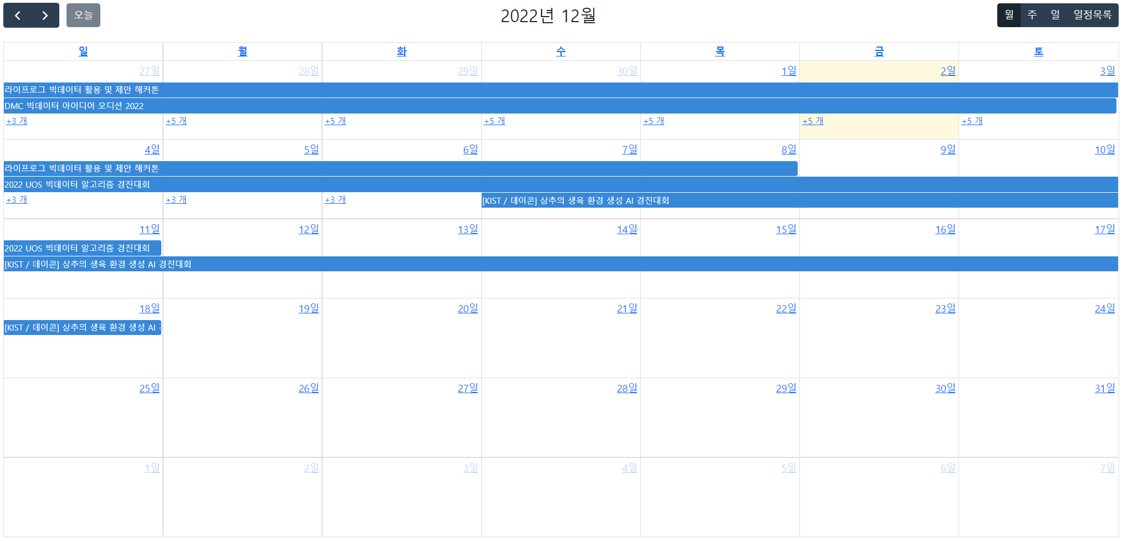
BE THE 1
Enjoy your stylish business and campus life with BIZCAM
How to use?
4. Calendar 사용하기

Slide 10
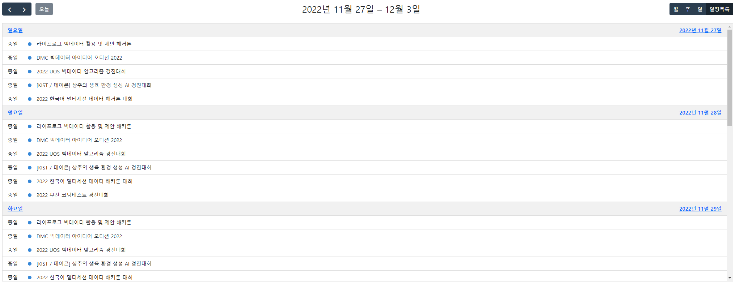
BE THE 1
Enjoy your stylish business and campus life with BIZCAM
How to use?
4. Calendar 사용하기

Slide 11
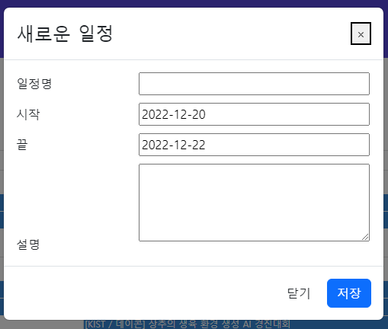
BE THE 1
Enjoy your stylish business and campus life with BIZCAM
How to use?
4. Calendar 사용하기

Slide 12
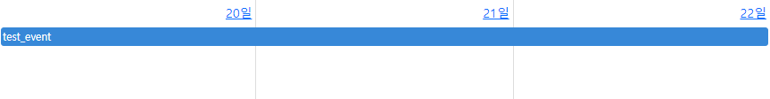
BE THE 1
Enjoy your stylish business and campus life with BIZCAM
How to use?
4. Calendar 사용하기

Slide 13
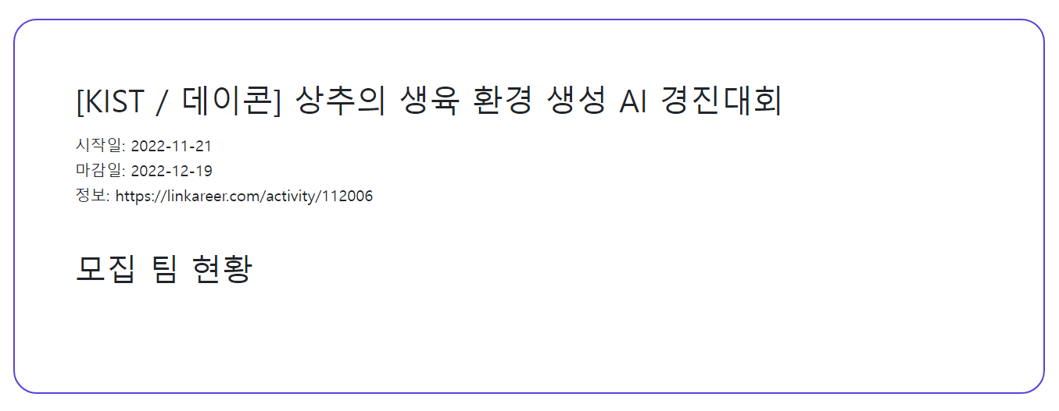
BE THE 1
Enjoy your stylish business and campus life with BIZCAM
How to use?
4. Calendar 사용하기

Slide 14
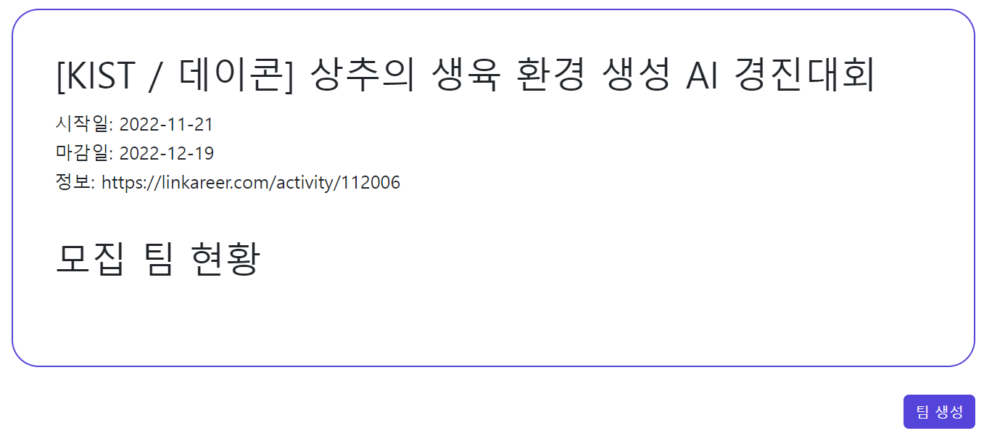
BE THE 1
Enjoy your stylish business and campus life with BIZCAM
How to use?
5. 팀 생성 및 참여하기

Slide 15
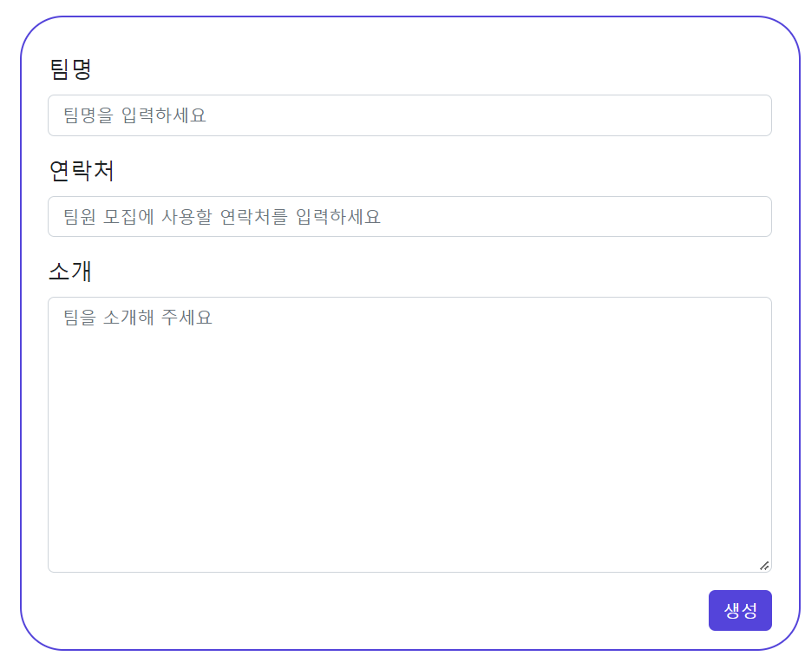
BE THE 1
Enjoy your stylish business and campus life with BIZCAM
How to use?
5. 팀 생성 및 참여하기

Slide 16
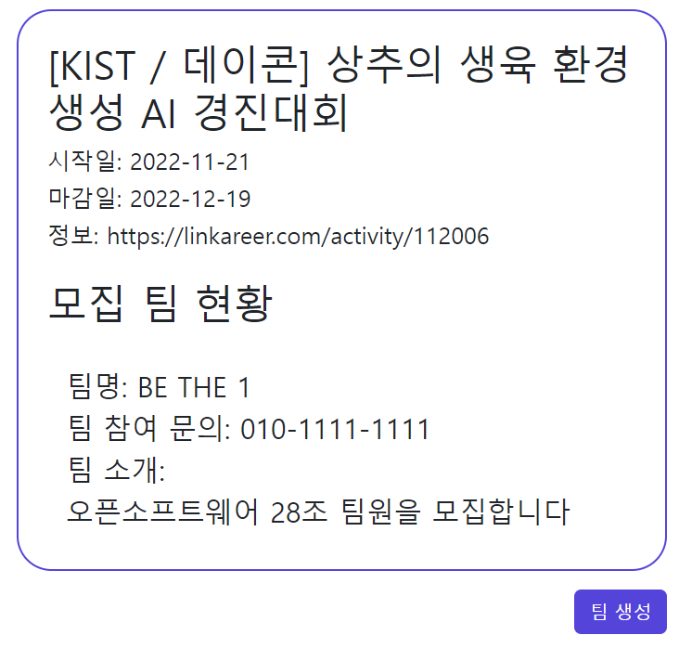
BE THE 1
Enjoy your stylish business and campus life with BIZCAM
How to use?
5. 팀 생성 및 참여하기

Slide 17
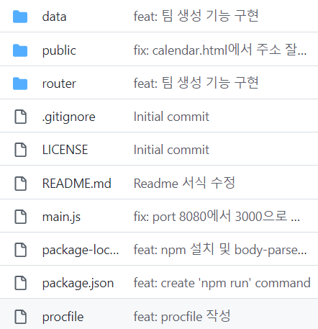
BE THE 1
Enjoy your stylish business and campus life with BIZCAM
Github
https://github.com/ossp-group28-final-project/final-project

Slide 18
BE THE 1
Enjoy your stylish business and campus life with BIZCAM
감사합니다!!
Ppt 출처: http://pptbizcam.co.kr/?p=10038

